Slide 1
Uva 11235
Frequent Values
Time: 3 seconds

Slide 2
Problem Descriptions
You are given a sequence of n integers a1, a2, . . . , an in “non-decreasing order”.
In addition to that, you are given several queries consisting of indices i and j (1 ≤ i ≤ j ≤ n). For each query, determine the most frequent value among the integers a_{i} , . . . , a_{j} .

Slide 3
Input
The input consists of several test cases.
Each test case starts with a line containing two integers n and q (1 ≤ n, q ≤ 100,000).
The next line contains n integers a₁, . . . , a_{n} (−100,000 ≤ a_{i} ≤ 100,000, for each i ∈ {1, ..., n}) separated by spaces. You can assume that for each i ∈ {1, . . . , n − 1}: a_{i} ≤ a_{i+1}.
The following q lines contain one query each, consisting of two integers i and j (1 ≤ i ≤ j ≤ n), which indicate the boundary indices for the query.
The last test case is followed by a line containing a single ‘0’.

Slide 4
Output
For each query, print one line with one integer: The number of occurrences of the most frequent value within the given range.
Note: A naive algorithm may not run in time!
HaHaHa!!!

Slide 5

Sample I/O
10 non-increasing number
3 queries
10 3
-1 -1 1 1 1 1 3 10 10 10
2 3
1 10
5 10
0
1
4
3
-1 -1 1 1 1 1 3 10 10 10
-1 -1 1 1 1 1 3 10 10 10
-1 -1 1 1 1 1 3 10 10 10

Slide 6
Solution
index | 0 | 1 | 2 | 3 | 4 | 5 | 6 | 7 | 8 | 9
 | -1 | -1 | 1 | 1 | 1 | 1 | 3 | 10 | 10 | 10
count | 0 | 1 | 2 | 3
 | 2 | 4 | 1 | 3
O(n)
type | 0 | 1 | 2 | 3 | 4 | 5 | 6 | 7 | 8 | 9
 | 0 | 0 | 1 | 1 | 1 | 1 | 2 | 3 | 3 | 3
O(n)
left | 0 | 1 | 2 | 3 | 4 | 5 | 6 | 7 | 8 | 9
index | 0 | 0 | 2 | 2 | 2 | 2 | 6 | 7 | 7 | 7
O(n)
right | 0 | 1 | 2 | 3 | 4 | 5 | 6 | 7 | 8 | 9
index | 1 | 1 | 5 | 5 | 5 | 5 | 6 | 9 | 9 | 9
O(n)

Slide 7
Query Case 1: type[L]==type[R]
count | 0 | 1 | 2 | 3
 | 2 | 4 | 1 | 3
Ans= R-L+1
Ans= 5-2+1=4
L
R
type | 0 | 1 | 2 | 3 | 4 | 5 | 6 | 7 | 8 | 9
 | 0 | 0 | 1 | 1 | 1 | 1 | 2 | 3 | 3 | 3
left | 0 | 1 | 2 | 3 | 4 | 5 | 6 | 7 | 8 | 9
index | 0 | 0 | 2 | 2 | 2 | 2 | 6 | 7 | 7 | 7
right | 0 | 1 | 2 | 3 | 4 | 5 | 6 | 7 | 8 | 9
index | 1 | 1 | 5 | 5 | 5 | 5 | 6 | 9 | 9 | 9

Slide 8
Query Case 2: type[L]!=type[R]
count | 0 | 1 | 2 | 3
 | 2 | 4 | 1 | 3
{right(L)-L+1}=1-1+1=1
?
{R-left(R)+1}=8-7+1=2
L
R
(1)
(2)
type | 0 | 1 | 2 | 3 | 4 | 5 | 6 | 7 | 8 | 9
 | 0 | 0 | 1 | 1 | 1 | 1 | 2 | 3 | 3 | 3
left | 0 | 1 | 2 | 3 | 4 | 5 | 6 | 7 | 8 | 9
index | 0 | 0 | 2 | 2 | 2 | 2 | 6 | 7 | 7 | 7
right | 0 | 1 | 2 | 3 | 4 | 5 | 6 | 7 | 8 | 9
index | 1 | 1 | 5 | 5 | 5 | 5 | 6 | 9 | 9 | 9

Slide 9
Query Case 2: type[L]!=type[R]
(3)
count | 0 | 1 | 2 | 3
 | 2 | 4 | 1 | 3
Ans=max{right(L)-L+1 , R - left[R]+1, max count (count[L+ 1] ~ count[R– 1])}
(1)
No. of type[L]
(2)
No. of num[R]
(3)
From count[L+1] To count[R-1] 之 max count
L
R
type | 0 | 1 | 2 | 3 | 4 | 5 | 6 | 7 | 8 | 9
 | 0 | 0 | 1 | 1 | 1 | 1 | 2 | 3 | 3 | 3
left | 0 | 1 | 2 | 3 | 4 | 5 | 6 | 7 | 8 | 9
index | 0 | 0 | 2 | 2 | 2 | 2 | 6 | 7 | 7 | 7
right | 0 | 1 | 2 | 3 | 4 | 5 | 6 | 7 | 8 | 9
index | 1 | 1 | 5 | 5 | 5 | 5 | 6 | 9 | 9 | 9

Slide 10
Query Case 2: type[L]!=type[R]
count | 1 | 2 | 3 | 4
 | 2 | 4 | 1 | 3
(3)
Ans=max(right(L)-L+1 , R - left[R]+1, max count (count[L+1] ~ count[R-1]))
(1)
No. of type[L]
(2)
No. of num[R]
(3)
From count[L]+1 To count[R]-1 之 max count
L
R
right(L)-L+1
R - left[R]+1
O(1)
max count
(count[L+1] ~ count[R- 1])
O(1)

Slide 11
RMQ-Sparse Table

Slide 12
Range Max/Min Query (RMQ)
cnt | 0 | 1 | 2 | 3 | 4 | 5 | 6 | 7 | 8 | 9 | 10 | 11 | 12 | 13
2⁰ | 2 | 4 | 5 | 3 | 9 | 3 | 11 | 6 | 13 | 1 | 7 | 16 | 8 | 15
2¹ | 4 | 5 | 5 | 9 | 9 | 11 | 11 | 13 | 13 | 7 | 16 | 16 | 15

Slide 13
Range Max/Min Query (RMQ)
cnt | 0 | 1 | 2 | 3 | 4 | 5 | 6 | 7 | 8 | 9 | 10 | 11 | 12 | 13
2⁰ | 2 | 4 | 5 | 3 | 9 | 3 | 11 | 6 | 13 | 1 | 7 | 16 | 8 | 15
2¹ | 4 | 5 | 5 | 9 | 9 | 11 | 11 | 13 | 13 | 7 | 16 | 16 | 15
2² | 5 | 9 | 9 | 11 | 11 | 13 | 13 | 13 | 16 | 16 | 16

Slide 14

Range Max/Min Query (RMQ)
N=14
cnt | 0 | 1 | 2 | 3 | 4 | 5 | 6 | 7 | 8 | 9 | 10 | 11 | 12 | 13
2⁰ | 2 | 4 | 5 | 3 | 9 | 3 | 11 | 6 | 13 | 1 | 7 | 16 | 8 | 15
2¹ | 4 | 5 | 5 | 9 | 9 | 11 | 11 | 13 | 13 | 7 | 16 | 16 | 15
2² | 5 | 9 | 9 | 11 | 11 | 13 | 13 | 13 | 16 | 16 | 16
2³ | 11 | 13 | 13 | 13 | 16 | 16 | 16
$\left\lfloor log(N)\right\rfloor$=3

Slide 15
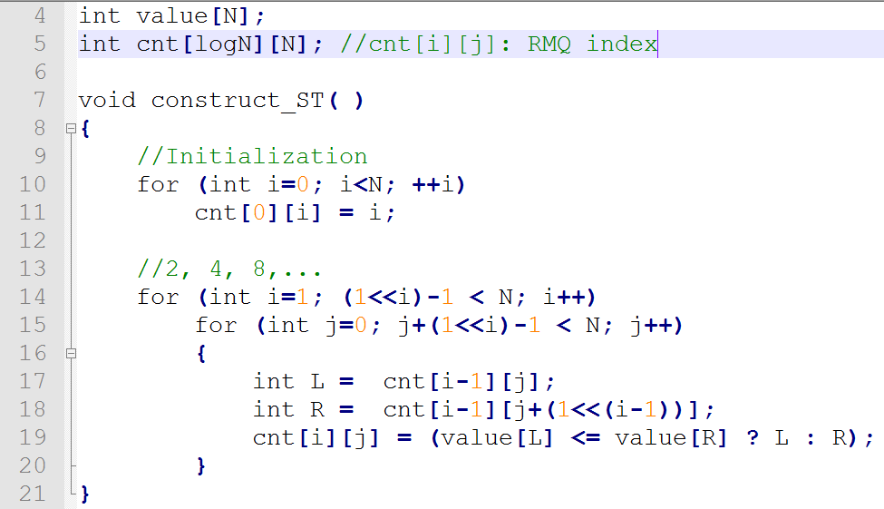
ST Construction
j+間隔

Slide 16
ST Query
(13-3)+1=11=0..01011
28個0
31-28=3
11 代表 2³=8 可以跨過一半
L
R
cnt | 0 | 1 | 2 | 3 | 4 | 5 | 6 | 7 | 8 | 9 | 10 | 11 | 12 | 13
2⁰ | 2 | 4 | 5 | 3 | 9 | 3 | 11 | 6 | 13 | 1 | 7 | 16 | 8 | 15
2¹ | 4 | 5 | 5 | 9 | 9 | 11 | 11 | 13 | 13 | 7 | 16 | 16 | 15
2² | 5 | 9 | 9 | 11 | 11 | 13 | 13 | 13 | 16 | 16 | 16
2³ | 11 | 13 | 13 | 13 | 16 | 16 | 16

Slide 17
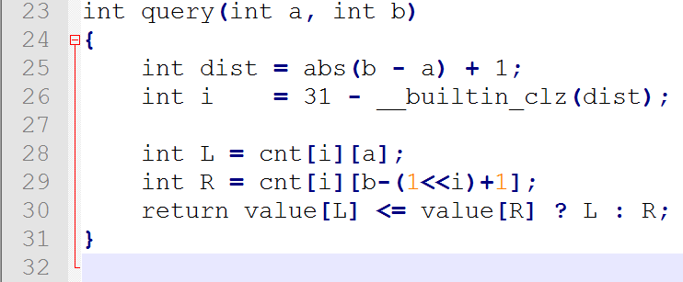
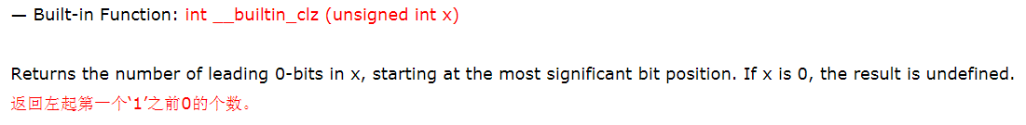
Query
dist 最左邊1在第幾個bit

Slide 18
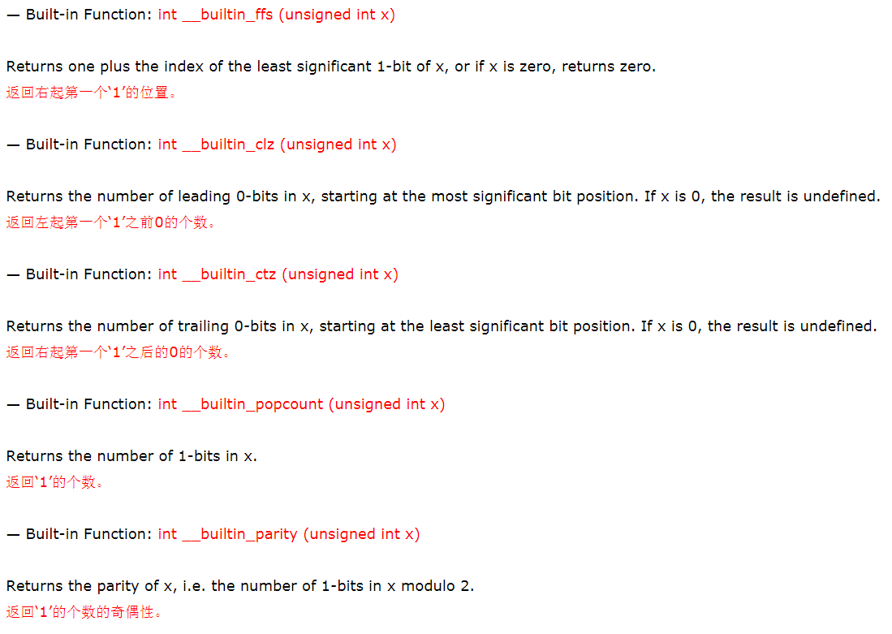

Slide 19
Drawback of Sparse Table
比較浪費空間
無法修改

Slide 20
Segment Tree

Slide 21
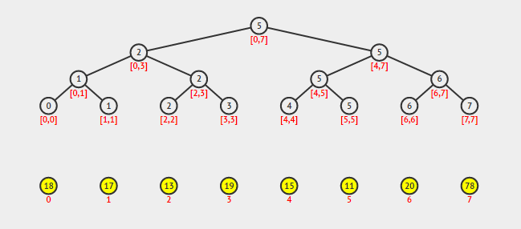
Segment Tree [0, 7]
M=1
M=3
M=5
M=0
M=2
M=4
M=6
1
2
3
4
5
6
7
8
9
10
11
12
13
14
15
M
M
M

Slide 22
Segment Tree [2, 5]=[2,3]+[4,5]
M=3
M=1
M=5
M=0
M=2
M=4
M=6
1
2
3
4
5
6
7
8
9
10
11
12
13
14
15
M
M
M

Slide 23
Segment Tree [2, 5]→ 5
M=1
M=3
M=5
M=0
M=2
M=4
M=6
1
5
2
3
2
5
4
5
6
7
1
2
5
6
8
9
10
11
12
13
14
15
0
1
2
3
4
5
6
7
0 | 1 | 2 | 3 | 4 | 5 | 6 | 7
18 | 17 | 13 | 19 | 15 | 11 | 20 | 78
M
M
M
Query the minimum of range [2, 5]: A[5] is the minimum.

Slide 24
Segment Tree [1,7]=[1,1]+[2,3]+[4,7]
M=1
M=3
M=5
M=0
M=2
M=4
M=6
1
2
3
4
5
6
7
8
9
10
11
12
13
14
15
M
M
M

Slide 25
Segment Tree [1, 7]→ 5
M=1
M=3
M=5
M=0
M=2
M=4
M=6
1
5
2
3
2
5
4
5
6
7
1
2
5
6
8
9
10
11
12
13
14
15
0
1
2
3
4
5
6
7
0 | 1 | 2 | 3 | 4 | 5 | 6 | 7
18 | 17 | 13 | 19 | 15 | 11 | 20 | 78
M
M
M
Query the minimum of range [1, 7]: A[5] is the minimum.

Slide 26
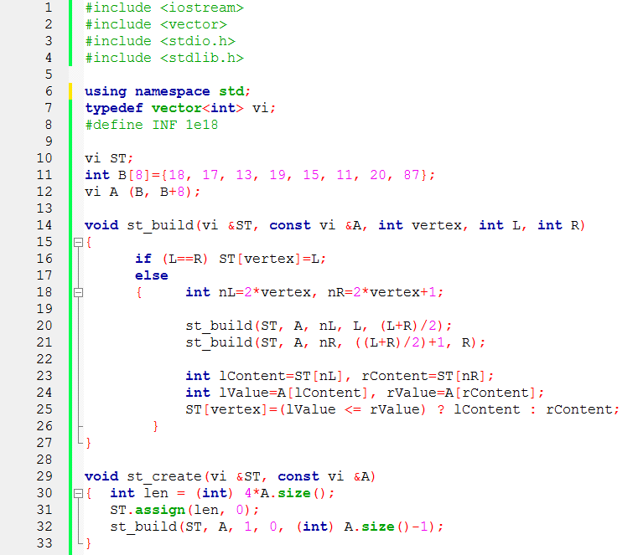
Build Segment Tree
$$ST array length is : 2×2^{\left\lfloor \log_{2}N\right\rfloor +1}$$

Slide 27
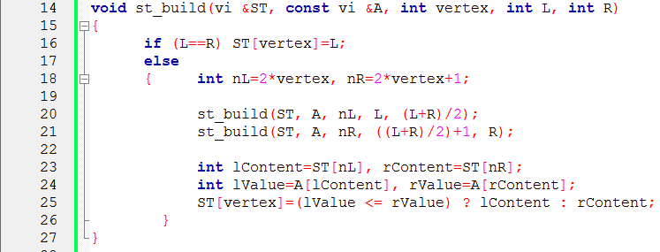
st_build(ST, A, 1, 0, 7)
nL=2
1
nR=3
ST
2
3
4
5
6
7
8
9
10
11
12
13
14
15
A
0 | 1 | 2 | 3 | 4 | 5 | 6 | 7
18 | 17 | 13 | 19 | 15 | 11 | 20 | 78
M
M
M

Slide 28
st_build(ST, A, 2, 0, 3)
1
ST
2
3
nL=4
nR=5
4
5
6
7
8
9
10
11
12
13
14
15
A
0 | 1 | 2 | 3 | 4 | 5 | 6 | 7
18 | 17 | 13 | 19 | 15 | 11 | 20 | 78
M
M
M

Slide 29
st_build(ST, A, 4, 0, 1)
1
ST
2
3
nL=8
4
5
6
7
nR=9
8
9
10
11
12
13
14
15
A
0 | 1 | 2 | 3 | 4 | 5 | 6 | 7
18 | 17 | 13 | 19 | 15 | 11 | 20 | 78
M
M
M

Slide 30
st_build(ST, A, 1, 0, 0)
1
ST
2
3
nL=8
4
5
6
7
nR=9
8
9
10
11
12
13
14
15
0
A
0 | 1 | 2 | 3 | 4 | 5 | 6 | 7
18 | 17 | 13 | 19 | 15 | 11 | 20 | 78
M
M
M

Slide 31
Segment Tree
1
5
2
3
2
5
4
5
6
7
1
2
5
6
8
9
10
11
12
13
14
15
0
1
2
3
4
5
6
7
0 | 1 | 2 | 3 | 4 | 5 | 6 | 7
18 | 17 | 13 | 19 | 15 | 11 | 20 | 78
M
M
M

Slide 32
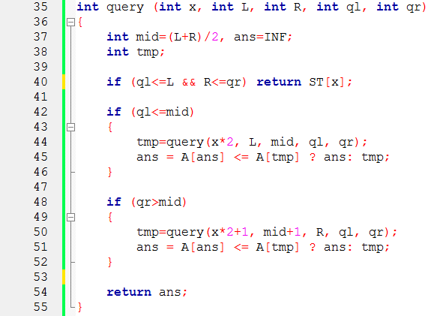
Query

Slide 33
Query [2, 5]
query (1, 0, 7, 2, 5)
mid=3
2
0
7
5
mid=3
1
5
2
3
2
5
4
5
6
5
7
1
2
6
8
9
10
11
12
13
14
15
0
1
2
3
4
5
6
7
0 | 1 | 2 | 3 | 4 | 5 | 6 | 7
18 | 17 | 13 | 19 | 15 | 11 | 20 | 78
M
M
M

Slide 34
Query [2, 5]
query (2, 0, 3, 2, 5)
mid=1
2
0
3
5
mid=1
mid=3
1
5
2
3
2
5
4
5
6
5
7
1
2
6
8
9
10
11
12
13
14
15
0
1
2
3
4
5
6
7
0 | 1 | 2 | 3 | 4 | 5 | 6 | 7
18 | 17 | 13 | 19 | 15 | 11 | 20 | 78
M
M
M

Slide 35
Query [2, 5]
[2, 5]=[2, 3]+[4,5]→ 5
M=1
mid=3
M=5
M=2
M=4
1
5
2
3
2
5
4
5
6
7
1
2
5
6
8
9
10
11
12
13
14
15
0
1
2
3
4
5
6
7
0 | 1 | 2 | 3 | 4 | 5 | 6 | 7
18 | 17 | 13 | 19 | 15 | 11 | 20 | 78
M
M
M

Slide 36
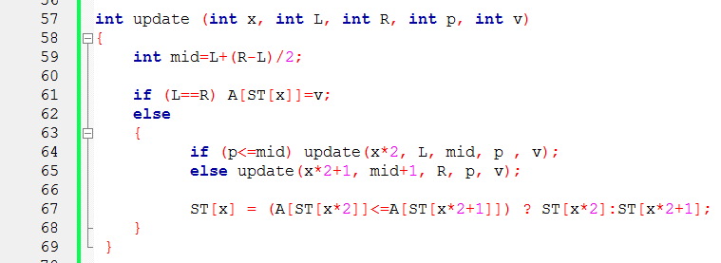
Update A[p]=v

Slide 37
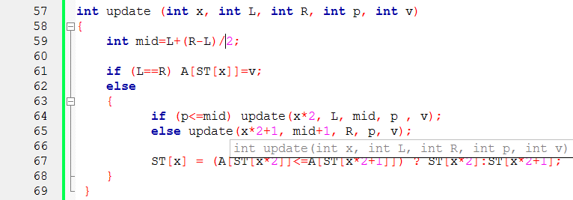
update A[4]=8
update (1, 0, 7, 4, 8)
mid=3
mid=3
M=5
M=4
M=6
1
4
5
2
3
4
2
5
4
5
6
4
7
1
2
5
6
8
9
10
11
12
13
14
15
0
1
2
3
4
5
6
7
0 | 1 | 2 | 3 | 4 | 5 | 6 | 7
18 | 17 | 13 | 19 | 15 | 11 | 20 | 78
M
M
8
M

Slide 38
update A[4]=8
update (3, 4, 7, 4, 8)
mid=5
mid=3
M=5
M=4
M=6
1
4
5
2
3
4
2
5
4
5
6
4
7
1
2
5
6
8
9
10
11
12
13
14
15
0
1
2
3
4
5
6
7
0 | 1 | 2 | 3 | 4 | 5 | 6 | 7
18 | 17 | 13 | 19 | 15 | 11 | 20 | 78
M
M
8
M

Slide 39
update A[4]=8
update (6, 4, 5, 4, 8)
mid=4
mid=3
M=5
M=4
M=6
1
4
5
2
3
4
2
5
4
5
6
4
7
1
2
5
6
8
9
10
11
12
13
14
15
0
1
2
3
4
5
6
7
0 | 1 | 2 | 3 | 4 | 5 | 6 | 7
18 | 17 | 13 | 19 | 15 | 11 | 20 | 78
M
M
8
M

Slide 40
update A[4]=8
update (12, 4, 4, 4, 8)
mid=4
mid=3
M=5
M=4
M=6
1
4
5
2
3
4
2
5
4
5
6
4
7
1
2
5
6
8
9
10
11
12
13
14
15
0
1
2
3
4
5
6
7
0 | 1 | 2 | 3 | 4 | 5 | 6 | 7
18 | 17 | 13 | 19 | 15 | 11 | 20 | 78
M
M
8
M

